Slide 1



F
I
R
S
T
C
O
R
N
A
N
I
T
H
I
S
15.39-58
A free CD of this message will be available following the service
It will also be available for podcast later this week at calvaryokc.com

Slide 2
A potion to cure ill health
A 55-gallon drum of chicken soup
A very large diamond
A long-lost relative had left you a minor-league baseball stadium
A dinner date with a famous movie star
MGM called, inviting you to dinner with Lassie tonight
O
A
N
S
15.39-58
I
I
F
I
R
S
T
C
R
N
T
H

Slide 3
Gen. 1:1 - In the beginning, God created the heavens and the earth.
bara – to create
Gen. 1:26 - Then God said, “Let Us make man in Our image …”
Asah – to make
O
A
N
S
15.39-58
I
I
F
I
R
S
T
C
R
N
T
H

Slide 4
Gen. 2:7 - And the Lord God formed man of the dust of the ground …
Yatsar – to form, fashion or mold
O
A
N
S
15.39-58
I
I
F
I
R
S
T
C
R
N
T
H

Slide 5
Eph. 4:8-10 - ⁸ Therefore He says:
“When He ascended on high,
He led captivity captive,
And gave gifts to men.”
⁹ (Now this, "He ascended" — what does it mean but that He also first
O
A
N
S
15.39-58
I
I
F
I
R
S
T
C
R
N
T
H

Slide 6
descended into the lower parts of the earth? ¹⁰ He who descended is also the One who ascended far above all the heavens, that He might fill all things.)
O
A
N
S
15.39-58
I
I
F
I
R
S
T
C
R
N
T
H

Slide 7
2 Cor. 5:8 - We are confident, yes, well pleased rather to be absent from the body and to be present with the Lord.
O
A
N
S
15.39-58
I
I
F
I
R
S
T
C
R
N
T
H

Slide 8
Phil. 1:21-24 - ²¹ For to me, to live is Christ, and to die is gain. ²² But if I live on in the flesh, this will mean fruit from my labor; yet what I shall choose I cannot tell. ²³ For I am hard- pressed between the two, having
O
A
N
S
15.39-58
I
I
F
I
R
S
T
C
R
N
T
H

Slide 9
a desire to depart and be with Christ, which is far better. ²⁴ Nevertheless to remain in the flesh is more needful for you.
O
A
N
S
15.39-58
I
I
F
I
R
S
T
C
R
N
T
H

Slide 10
1 Thess. 4:15–17 - ¹⁵ For this we say to you by the word of the Lord, that we who are alive and remain until the coming of the Lord will by no means precede those who are asleep. ¹⁶ For the Lord Himself will descend from heaven with a shout, with the voice
O
A
N
S
15.39-58
I
I
F
I
R
S
T
C
R
N
T
H

Slide 11
Of an archangel, and with the trumpet of God. And the dead in Christ will rise first. ¹⁷ Then we who are alive and remain shall be caught up together with them in the clouds to meet the Lord in the air. And thus we shall always be with the Lord.
O
A
N
S
15.39-58
I
I
F
I
R
S
T
C
R
N
T
H

Slide 12

Old Testament Saints
Spirits in heaven
Spirits and bodies in heaven
The Cross
The Rapture
500
1000
1500
2000
2500
Church Age
Millennium
Abraham’s bosom
O
A
N
S
15.39-58
I
I
F
I
R
S
T
C
R
N
T
H

Slide 13
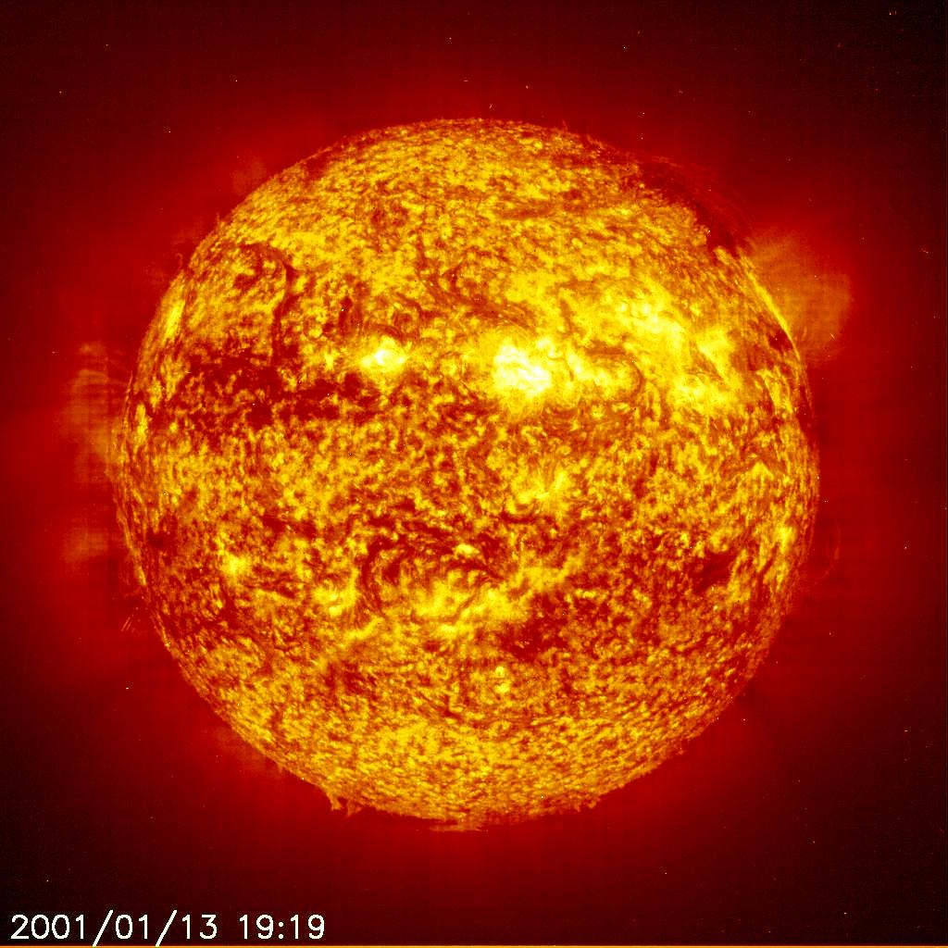
You are here
8 min.
20 sec.
O
A
N
S
15.39-58
I
I
F
I
R
S
T
C
R
N
T
H

Slide 14
Jewish Proverb – “Every man knows he will die, but no one wants to believe it.”
A. W. Tozer - “God's eternity and man's mortality join to persuade us that faith in Jesus Christ is not optional.”
O
A
N
S
15.39-58
I
I
F
I
R
S
T
C
R
N
T
H

Slide 15

O
A
N
S
15.39-58
I
I
F
I
R
S
T
C
R
N
T
H

Slide 16

Moment - atomos
a – negative particle
tomōteros – to cut or slice
Hence, that which cannot be cut
Atom
O
A
N
S
15.39-58
I
I
F
I
R
S
T
C
R
N
T
H

Slide 17
Oswald Chambers – “Death is God's delightful way of giving us life.”
O
A
N
S
15.39-58
I
I
F
I
R
S
T
C
R
N
T
H

Slide 18
C. H. Spurgeon - “The righteous are put into their graves all weary and worn; but as such they will not rise. They go there with the furrowed brow, the hollowed cheek, the wrinkled skin; they shall wake up in beauty and glory.”
O
A
N
S
15.39-58
I
I
F
I
R
S
T
C
R
N
T
H

